Slide 1
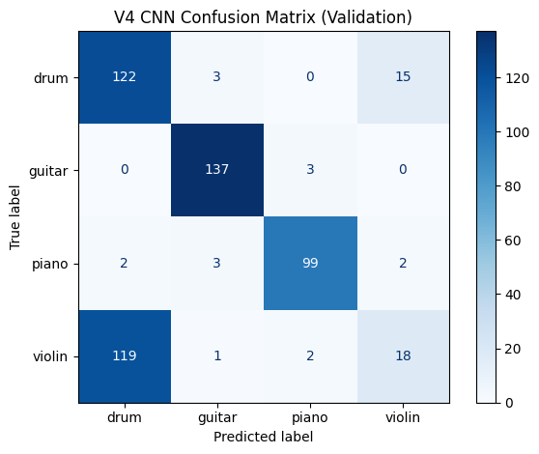
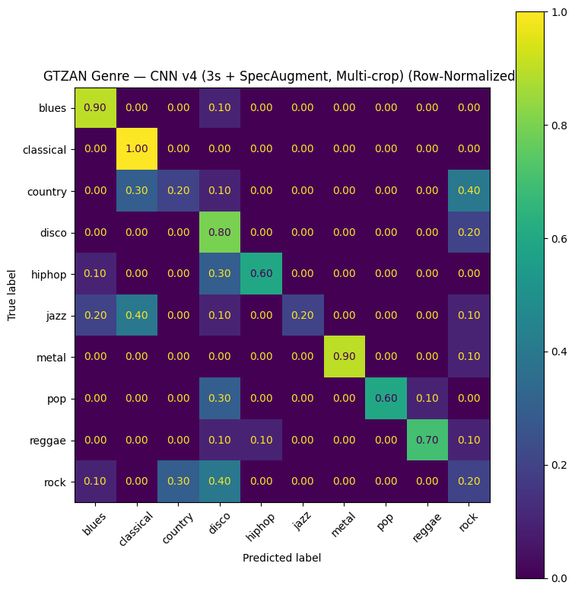
Music Classification with Signal Processing and CNNs
Coleman Bryant & Daniel Zelinger · TECHIN 513 · Separate genre and dominant-instrument models
Problem, Data, and Features
Genre Classification (GTZAN)
Goal
Key result
Instrument Classification
Predict music genre and the dominant instrument from short audio clips.
Used explainable DSP features first, then compare against compact CNNs trained on mel-spectrograms.
The CNN pipeline worked, but recreated runs were sensitive to configuration and did not consistently beat the baseline. That made reproducibility and class-level error analysis central findings.
Instrument
Baseline: 0.48
Validation accuracy progression
Best overall v4 confusion matrix
Run summary
0.65
Confusion matrix: strongest recorded historical v4 (0.77)
Base
0.48
22.05 kHz mono audio, 3 s crops, 64-bin log-mel spectrograms.
Genre demo uses 10-crop averaging for more stable inference after reconnects.
Base
CNN v2
0.73
CNN v1
0.68
CNN v3
0.62
CNN v2
0.68
Model Comparison
v4 best
0.77
CNN v3
0.71
Datasets
CNN v4
0.71
GTZAN: 999 usable clips across 10 genres.
Kaggle Musical Instrument’s Sound Dataset: 4 classes (drum, guitar, piano, violin).
v4 recreate
0.63
6 crops
0.61
Feature pipeline
No SG
0.64
4-class instrument classifier trained on a Kaggle audio dataset to predict the dominant instrument: drum, guitar, piano, or violin.
Baseline logistic regression: 0.65
Best reproducible recent CNN: 0.64
Strongest recorded historical CNN: 0.77
Dataset and task
Class-level takeaways
Error Analysis
Guitar and piano were classified more reliably, while violin was frequently confused with drum, showing that some instrument classes were more separable than others in the current feature setup.
CNN progression: 0.68 → 0.68 → 0.71 → 0.71
Classical, metal, and hiphop were often among the strongest classes.
Rock stayed difficult and was frequently confused with nearby styles.
Country, disco, and jazz were less stable across reruns and ablations.
Workflow and Limits
Reconnect-safe setup: load model + labels from Google Drive, then run a single prediction cell.
System is unified but not multitask: each model outputs one label, not multi-instrument tags.
Google Colab reconnecting major issue with models
Combining into one model proved difficult
Chaos Theory- Butterfly Effect
Interpretation
CNNs improved the baseline substantially, especially for guitar and piano.
Best overall accuracy came from v4 (0.7148), but v3 was the more balanced alternative.
Persistent failure mode: strong confusion between violin and drum.
Reproducibility note
An earlier 0.77 run could not be fully recovered because artifacts were not saved before a Colab session ended. Rebuilding the workflow later produced 0.61–0.64, turning an error into a lesson about experiment tracking.
Takeaway: the project delivered a working two-model music analysis demo, while also showing that reproducibility, ablation testing, and class-level error analysis matter as much as headline accuracy. Recreating the necessary conditions to replicate model accuracy exactly is difficult.
Notes:
[Sources] - Uploaded report document: /mnt/data/ML_DSP Final (1).docx - Genre metrics and narrative from uploaded report: baseline 0.65; CNN v2 0.73; CNN v3 0.62; historical v4 0.77; recreated runs 0.61-0.64; reproducibility note; class-level observations. - Instrument metrics and narrative from uploaded report: baseline 0.4848; CNN v1 0.6806; CNN v2 0.6825; CNN v3 0.7110; CNN v4 0.7148; violin-drum confusion; Beethoven demo framing. - Confusion matrix assets embedded from the uploaded report DOCX media: image14.png (GTZAN CNN v4 row-normalized), image11.png (instrument v4 confusion matrix). - Instrument dataset title based on the user-provided Kaggle dataset link in chat: Musical Instrument’s Sound Dataset.

